Slide 1

Bayesian Networks
John Torres – December 2020
Semillero Data Science para mejoramiento the procesos– Universidad del Valle

Slide 2
Content
I. Bayesian Theorem
I1. Bayesian Networks Definition
III. Example of Bayesian Network
IV. Monty Hall Problem

Slide 3
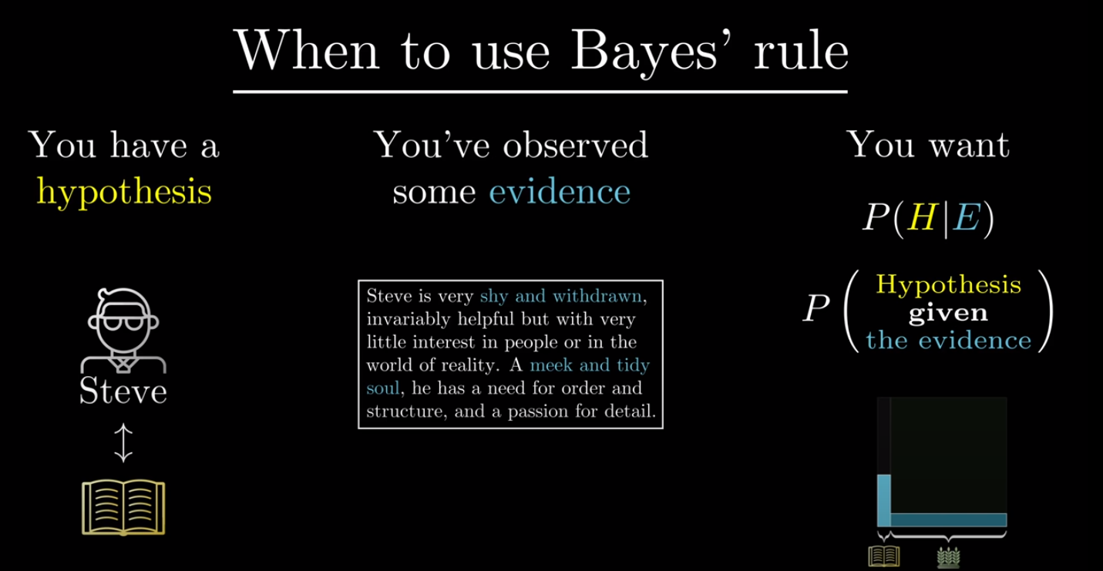
I. Bayesian Theorem
Librarian or Farmer?
https://www.youtube.com/watch?v=HZGCoVF3YvM&t=290s&ab_channel=3Blue1Brown

Slide 4
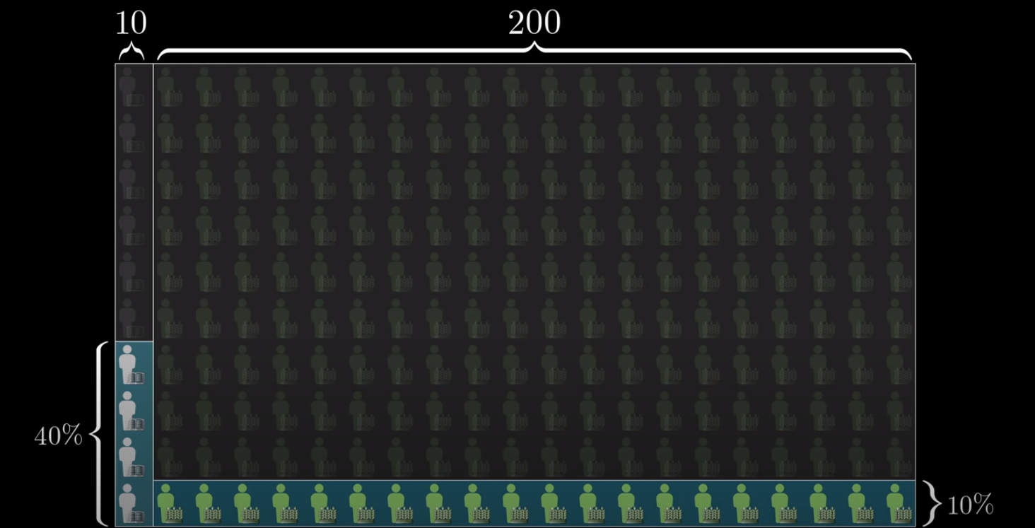
I. Bayesian Theorem
Librarian or Farmer?
https://www.youtube.com/watch?v=HZGCoVF3YvM&t=290s&ab_channel=3Blue1Brown

Slide 5
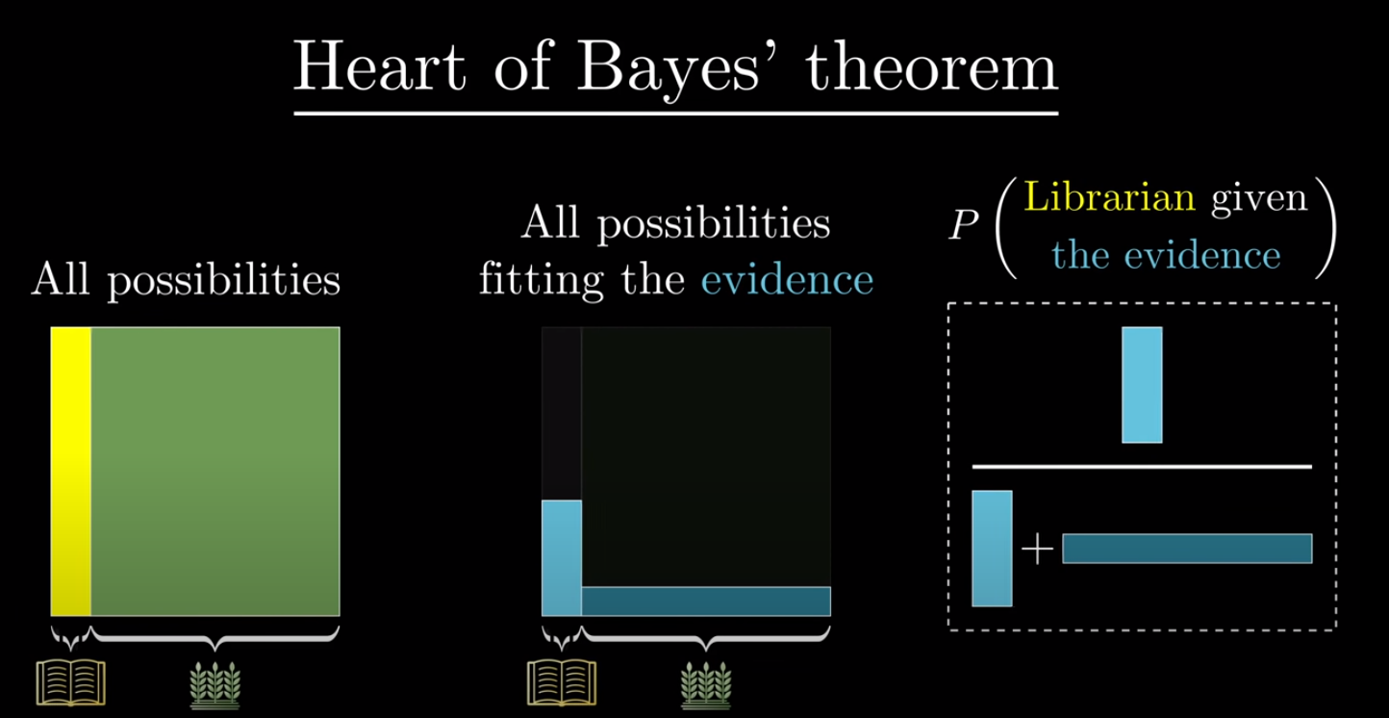
I. Bayesian Theorem

Slide 6
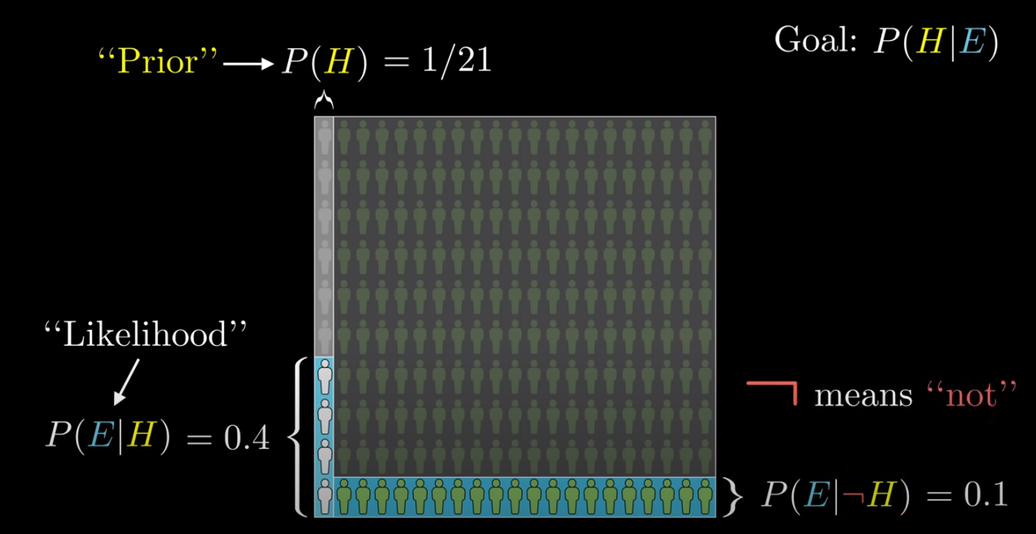
I. Bayesian Theorem
Hypothesis: Steve is a librarian given the description.

Slide 7
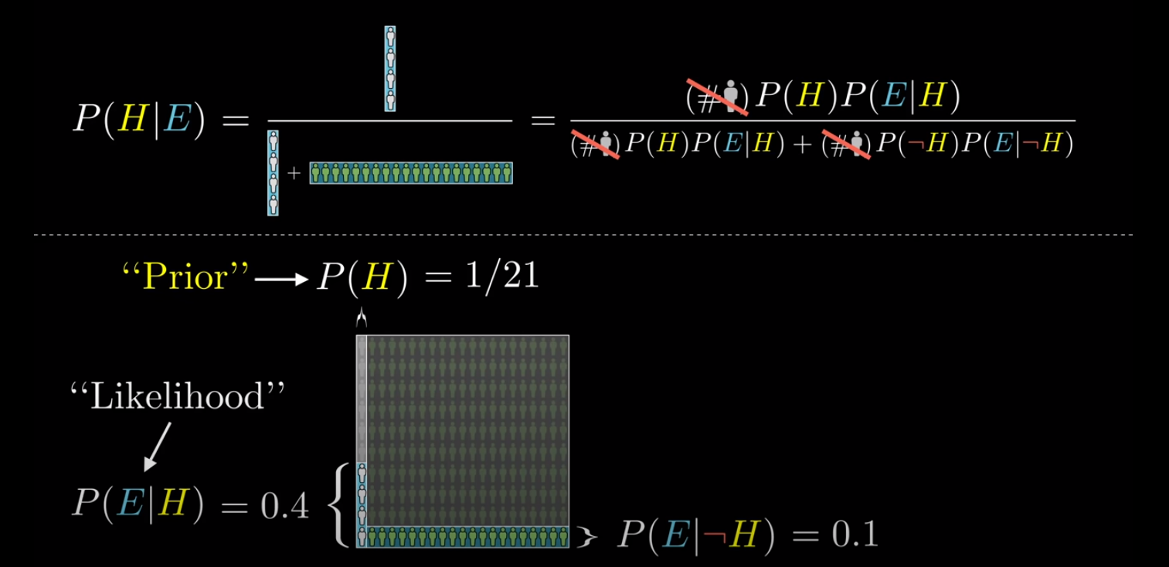
I. Bayesian Theorem

Slide 8
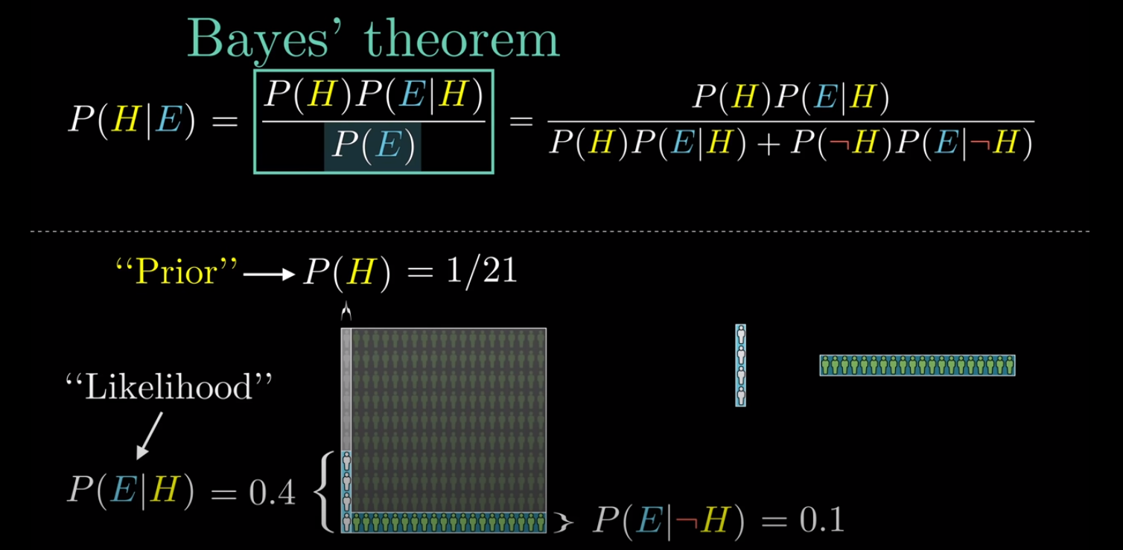
I. Bayesian Theorem
Posterior:
The believe that the hypothesis holds after seeing the evidence.
Prior:
The believe that the hypothesis holds before seeing the evidence.

Slide 9
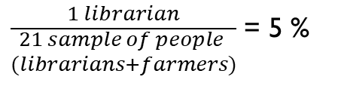
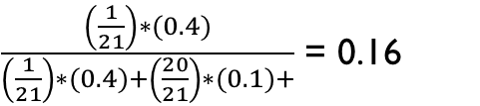

I. Bayesian Theorem
Posterior:
The believe that the hypothesis holds after seeing the evidence.
Prior:
The believe that the hypothesis holds before seeing the evidence.
Posterior:
$\frac{4 librarian}{4 librarian+20 farmers }$ = 0.16
Prior:
$\frac{1 librarian}{\begin{aligned}21 sample of people \\ (librarians+farmers)\end{aligned}}$ = 5 %
$\frac{\left(\frac{1}{21}\right)∗(0.4)}{\left(\frac{1}{21}\right)∗(0.4)+\left(\frac{20}{21}\right)∗(0.1)+}$ = 0.16
Base Rate

Slide 10
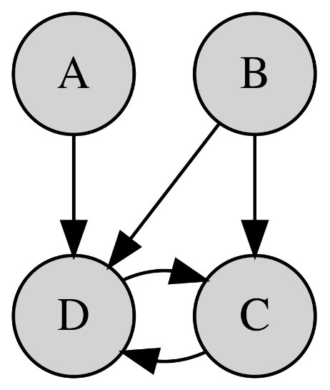
I1. Bayesian Networks Definition
A Bayesian Network falls under the category of Probabilistic Graphical Modelling (PGM)
They model uncertainties by using Directed Acyclic Graph
Edges represent dependency → Conditional Probability.
They are suitable for inference given incomplete data.

Slide 11
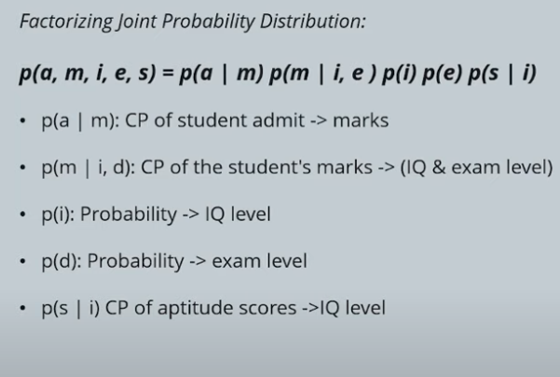
III. Example of Bayesian Network
Hard Ex. | Easy Ex.
0.7 | 0.3
High IQ | Low IQ
0.8 | 0.2
Exam level
IQ Level
IQ | Exam | High G | Low G
High | Hard | 0.6 | 0.4
High | Easy | 0.9 | 0.1
Low | Hard | 0.5 | 0.5
Low | Easy | 0.3 | 0.7
Grade
Apt. Score
 | High Ap. | Low Ap.
High IQ | 0.75 | 0.25
Low IQ | 0.4 | 0.6
Admission
 | Admitted | Not admitted
High Grade | 0.6 | 0.4
Low Grades | 0.3 | 0.7

Slide 12
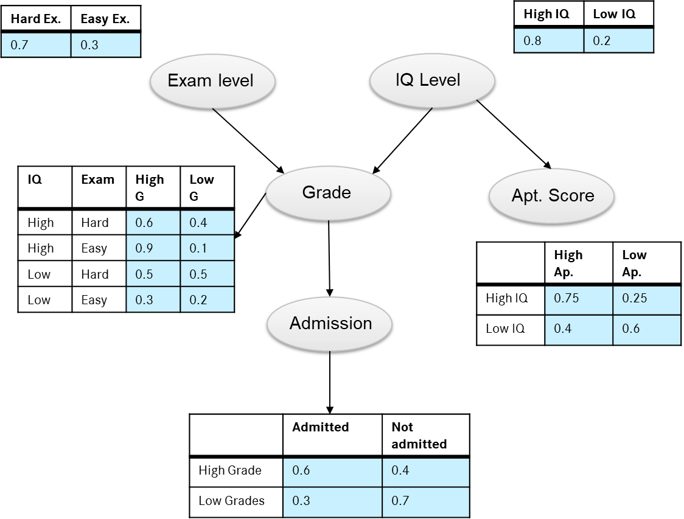
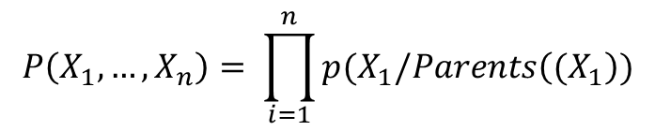
III. Example of Bayesian Network
The probability of a ramdom variable depends on the conditional probability with his parents.
$$P\left(X_{1},…,X_{n}\right)= \prod_{i=1}^{n}{p(X_{1}/Parents\left((X_{1}\right)})$$

Slide 13
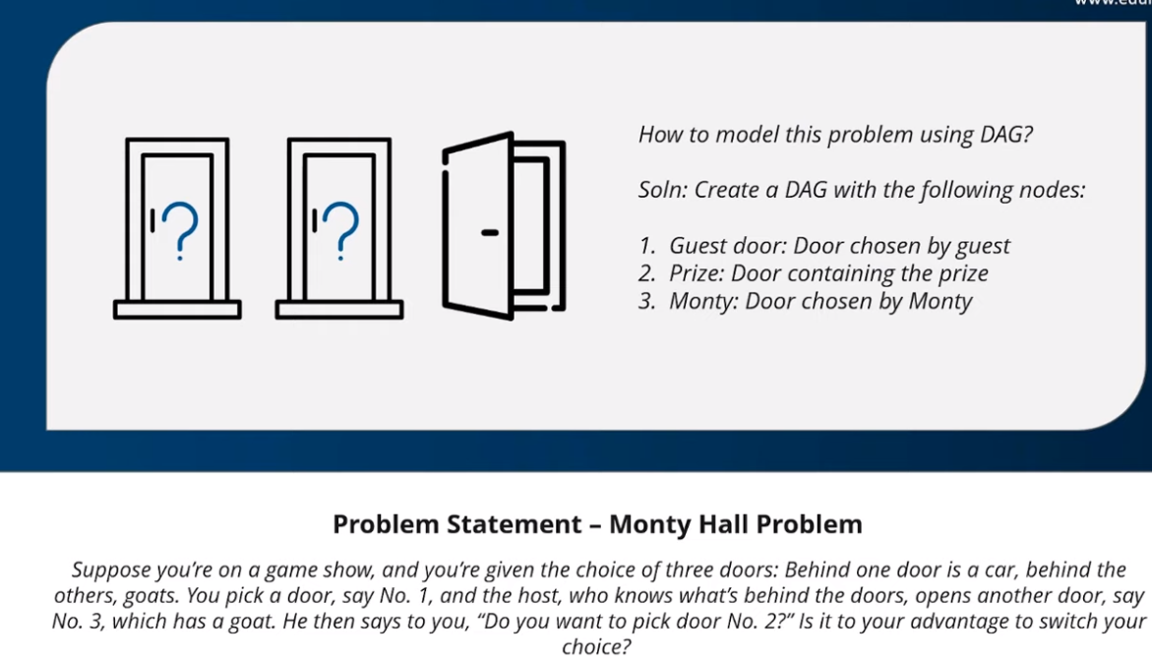
IV. Monty Hall Problem

Slide 14
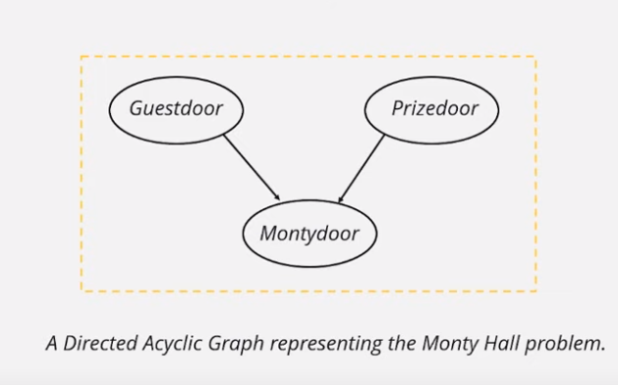

IV. Monty Hall Problem
DEMO: Modelling and solution with python package pomegranate.

